Slide 1


Github for Kids
21 May 2023

Slide 2
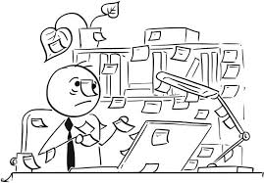
What is your job?

Slide 3
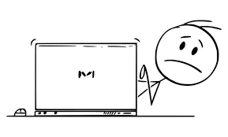
What is your role in society?

Slide 4

Producer VS consumer

Slide 5

GitHub is a kind of community

Slide 6
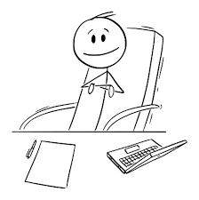
First step: enter the community
Create an account
Professional profile
.md

Slide 7

Benefit from the resources of this community
Topics
Tags
Repository
Download
Clone

Slide 8

Add your ideas and code to the community
Standard Project
Make your first Repository

Slide 9
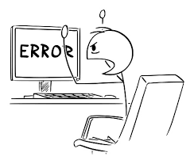
Find the mistakes

Slide 10
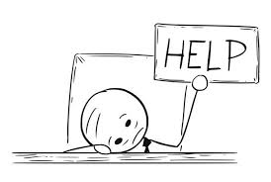
Get help from the community
Issus
Pull request

Slide 11

Find out the mistakes of others

Slide 12
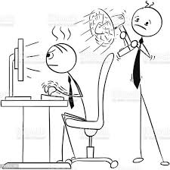
Look for a solution
Stackoverflow is the angel of salvation

Slide 13

Solve other people's problems
Achievements
Increase your account credit

Slide 14
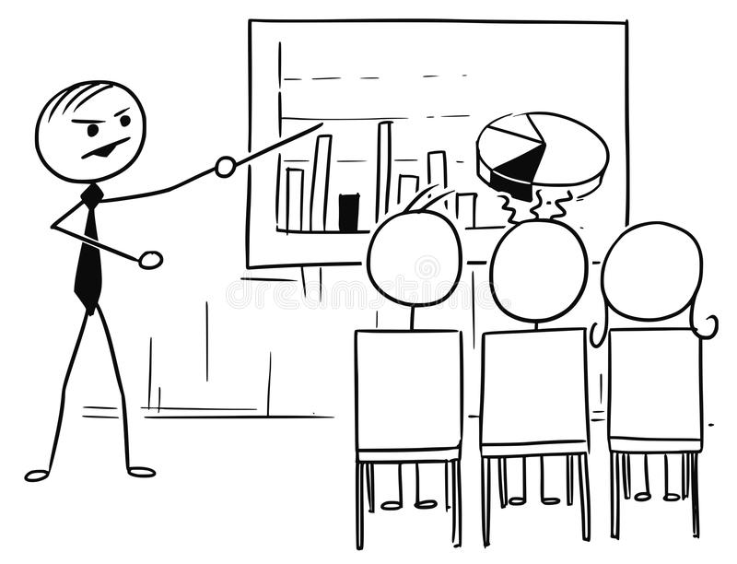
Plan the project

Slide 15
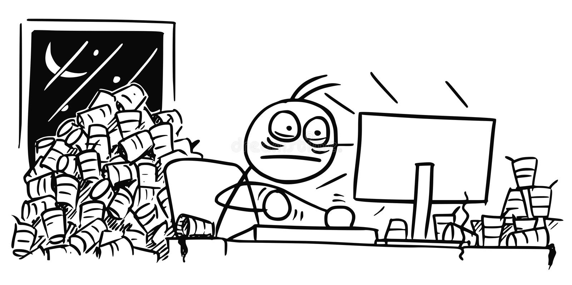
Do your tasks

Slide 16
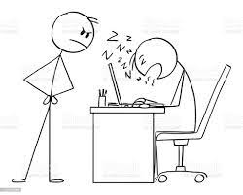
Monitor team performance

Slide 17

Enjoy your growth in the programming world

Slide 18
Thank you very much
Sajjad Ranjbar

